Slide 1

Personalized Education Curriculum System (PECS)
SS XABA (Simnandi Solutions (Pty) Ltd, CEO)

Slide 2
Glines (2012:176) predictively quotes from Anthony Blair that revolution, like in politics and economy, will occur in education too, where there would be a movement against the education system that; every child at the same age has to choose from a compulsory list of subjects as his curriculum. Glines reveals that this revolution will introduce and develop an education system directed to the particular talents and interests and ambitions of every child. It can be confirmed thus that this revolution is now upon our time as it is an uncontradictable reality that the South African education system fails to explicitly provide appropriately personalized education for the secondary school learners.
Matsose (2017) justifies this reality by arguing that South Africa’s education system does not cater for the different talents and educational needs that children in South Africa have. Matsose (2017) argues that not all children are academically gifted. Matsose (2017) further points out that a child who fails because of this does not signify his own failure but that of the education system because it cannot nurture the non-academic talents of the child.

Slide 3
The same argument is further indicated by the Principal in Singapore. Couros, (2016) shared a letter on the blog “The Principal of Change: Stories of learning and leading.” In this letter, the Singapore’s Principal alerted the parents to support their children irrespective of the exam results.
The plea to the parents was based on the fact that not all children are meant for the education provided to them and the system through which it is provided, but some, amongst other learners, are talented and passionate about fields like law, professional chefs, drama and performing artists, entrepreneurship, journalism etc. And these learners wish to pursue careers based on their talents and on the mentioned fields. Amongst the heartfelt words the Principal`s letter consisted of (Couros, 2016) are; “some learners (who will sit for the exam) are artists and they really don’t need Maths, an entrepreneur who does not care about History or English literature, a musician whose chemistry marks won`t matter, sportsperson whose physical fitness is more important than Physics as a subject.”

Slide 4
It becomes clear that there should be a development of education systems that must be tailored to serve what learners are ambitious about in life, and not the education system that forces and imposes itself onto learners to deal with a school curriculum that proves to be irrelevant from what children wish to pursue in life. Gatto, (2005: 24) believes that it is absurd and anti-life to be part of this mass school curriculum system that compels learners to sit in confinement with people(other learners) of exactly the same age and social class. Gatto (2005:24) further argues that this system effectively cuts learners off from the immense diversity of life and the synergy of variety; indeed, it cuts them off from their own past and future, sealing them in a continuous present much the same way television does.

Slide 5
Gardner (2009:1) observes that throughout most of history, not all the households have been able to afford an education geared to the individual learner (Personalized education), which resulted in education remaining a mass affair for majority of countries, with standard curricula, pedagogy, and assessments. South Africa, following apartheid regime, could relate to (Gardner, 2006:1) observations as education system was racially grouped and thus, unequal (Carrim, ‎2006:172). Gardner (2009:1) argues that so long as we insist on teaching all students the same subjects in the same way, progress will be incremental. The risk of advancing the education system that compels learners in one model of schooling (mainstream schooling) under which South Africa operates, is incremental results such as high rates of “progressed learners”, drop outs, unemployment, and a workforce that lack skills and a will to do the work which, in turn, negatively impacts on the economy of the country. That is why (Gatto, 2005:31) recommends that an invention of a curricula is needed where each kid has a chance to develop private uniqueness and self-reliance. And this recommendation points out to personalized education model.

Slide 6
Matsose, 2017 argues that the current curriculum in SA is hard to deal with, disengaging, irrelevant, and bossy (forcing the learners to do subjects that do not assist them to connect to their dreams in life). These are the learners who hold a remarkable burning desire and talents to be professional sportspeople, drama and performing artists, entrepreneurs, professional chefs, educational leaders, lawyers, journalists etc. These learners are at risk of being unsuccessful in life as they face academic success uncertainties with the difficulties they face in the current school curriculum that does not explicitly cater for their educational needs.

Slide 7
Examples of irrelevancy of the SA Curriculum
A learner who holds a remarkable passion about politics and has always dreamt of him/herself in the political arena as a parliamentarian, minister, president or unionist etc. is bored in school and slowly losing interest in schooling, if not lost already. This is because such a learner should be already doing subjects such as Politics, History, Public governance, International relations, Leadership, and Political professional ethics. Now, the problem is that there is not even a single public secondary school in South Africa that offers these subjects except History! A learner such as this one would therefore be bored and lose interest in schooling and arguably develop behavioural problems in the classroom. The reason for this would be the fact that the school curriculum system is excluding the personal traits and interests of this learner.

Slide 8
Examples of irrelevancy of the SA Curriculum
A learner passionate about Journalism and Media studies is currently lost and hates school. She/He has already lost hope of becoming a Journalist, News reporter, Media communications specialist etc. This is because the learner is in the public secondary school, where there’s no subject or any practical learning programme in line with what he/she hopes for in life. Subjects like; Broadcast journalism, News reporting, Communications (Languages – English and other languages), Media Studies, Editing, Professional skills etc. The curriculum system in South Africa doesn’t cover such a range of subjects in its public schooling. Only private schooling curriculum system can offer this in the name of “School of Journalism and Media Studies”. Thus, this learner is again excluded by the curriculum system as it doesn’t cater for his/her desired career path. One wonders thereafter, what is this learner being taught at school?.

Slide 9
Examples of irrelevancy of the SA Curriculum
Same applies with learners interested in Law, no South African secondary school offers Constitution as a subject, alongside with Legal studies, Roman law or Family law etc. These learners are bound to feel left out by the curriculum system. Even though the NCS 20 credit recognized subjects such as Drama, Art, and EGD etc, and such are at the learners disposal, however they are not well structured, because learners take these subjects with other irrelevant subjects that normally hinder the progress of their schooling careers. There should be transformation of the current curriculum and restructuring of the education system, to be in accordance with learners career paths rather than the current mass schooling system South Africa has.

Slide 10
What is the solution? What is to be done?
Introduce PERSONALIZED EDUCATION CURRICULUM SYSTEM =This is the education system that caters for the unique personal traits and future desires of an individual child. It is an individualized curriculum system that seeks to fuel learners straight to their career path through a carefully designed programme of assessment and an innovative teaching plan. This curriculum system means that education is theoretical – practical balanced and future orientated. This curriculum is a responsive tool that encourages individuality and is career path focused rather than mass education system, where aspiring lawyers, doctors, pilots, politicians, actuaries, chefs etc. are all in one classroom, taught by one teacher, with one teaching style. This is a curriculum system that seeks to protect a learner from doing irrelevant subjects from his/her career path – an engineer doesn’t need English literature (Romeo and Juliet or Hamlet) and Trigonometry and solve for x can be a stumbling block for an aspiring journalist or lawyer! This is a far-reaching education curriculum system that seeks to put learning and teaching into perspective.

Slide 11
How can the proposed PECS be structured?
School of Law
School of Engineering (Civil, Electrical, Mechanical)
School of Commerce&Entrepreneurship – Accounting, Economics, BS
School of Journalism, Drama and Arts
School of Agriculture, Surveying & Land Reform
School of Sciences (Physical, life sciences) and mathematics
School of Sports (Range of sporting codes)
School of Politics and public governance – Presidency, ministry, etc
School of Computer Application Technology

Slide 12
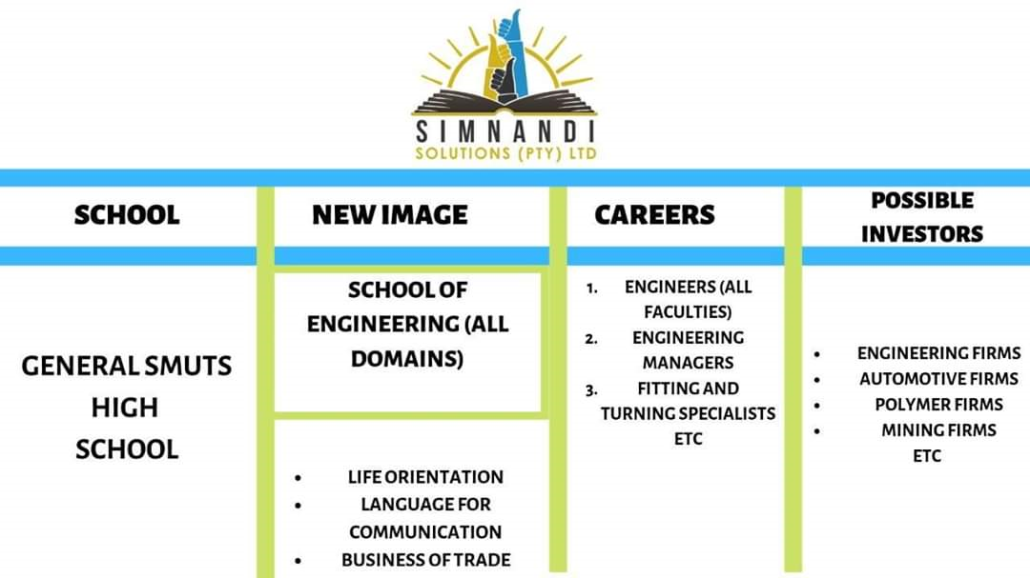

Slide 13
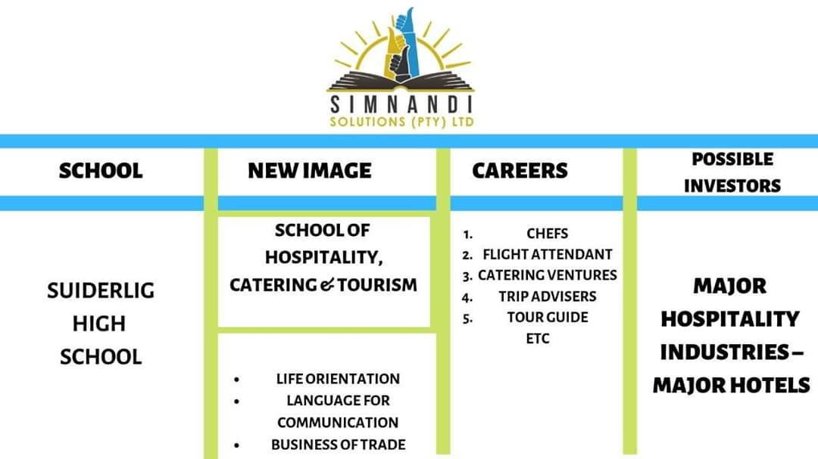

Slide 14
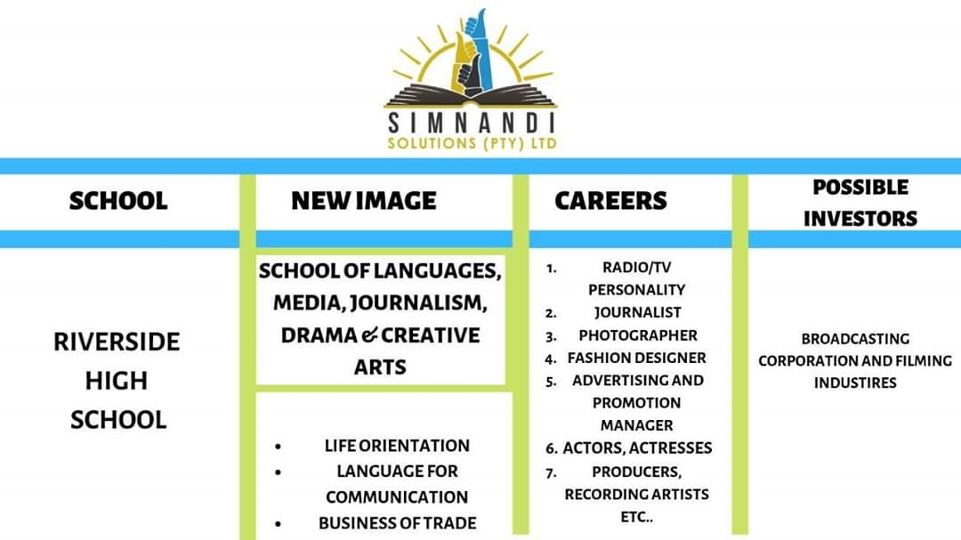

Slide 15
THANK YOU

